Slide 2


Bone Marrow Stromal Cell Antigen-2 (bst-2) Gene Variants associate with HIV-1 Control in black South African Individuals
Bianca Da Costa Dias
Share your thoughts on this presentation with #IAS2019

Slide 3

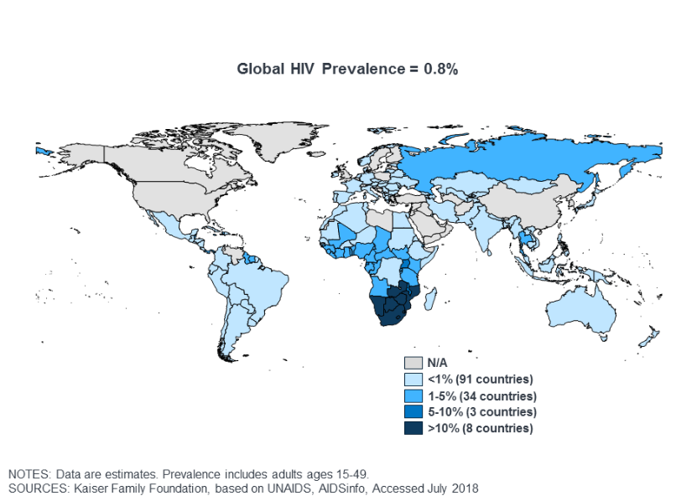

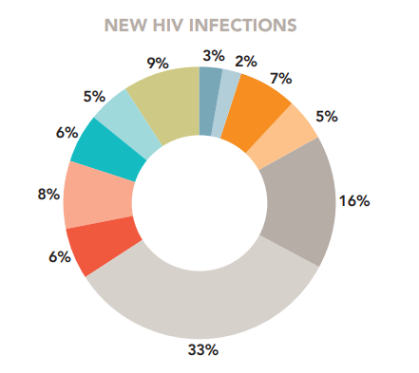

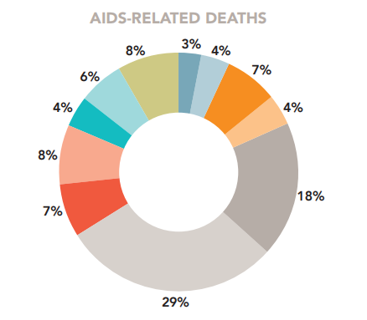
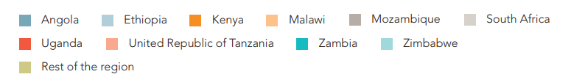
HIV-1: A Global epidemic with a South African HOTSPOT
East and Southern Africa
(19.6 million)
36.9 million PLHIV in 2017 globally
7.2 million PLHIV
19% of global #
270 000 new infections
15% of global #
110 000 AIDS-related deaths
11% of global #
Source: UNAIDS 2018 estimates
Notes:
As we know, in 2017 there were 37 million adults between the ages of 15-49 living with HIV globally with lastest UNAIDS data revealing that this number increased by approximately 1 million people in 2018. However, the epidemic disproportionally affects certain regions with Africa accounting for 2/3rds of global number of people living with HIV. But, even within the African region there is a clear disparity, with countries in eastern and southern sub-Saharan Africa having the highest disease prevalence. And at a country level, it is South Africa that accounts for a third of new infections and AIDS-related deaths in this region.
South Africa has the largest HIV epidemic in the world, with 19% of the global number of people living with HIV, 15% of new infections and 11% of AIDS related deaths. And so it is evident that the South African population bears THE GREATEST HIV burden in the world.
The scale of the region’s HIV epidemic, however, remains massive. An estimated 800 000 [650 000–1 000 000] people in eastern and southern Africa acquired HIV in 2017, and an estimated 380 000 [300 000–510 000] people died of AIDS-related illness.

Slide 4
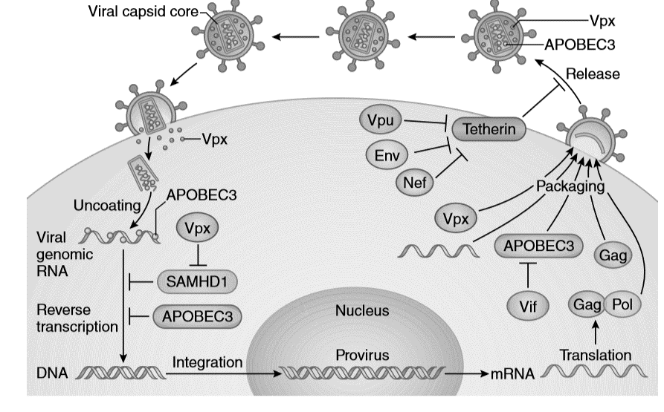
Host Genetics contributes to variability in HIV-1 disease
Host genetic factors associated with variability in HIV-1 disease
Host-encoded viral restriction factors
 | Gene
HIV-1 entry | Receptors: CCR5, CCR2, CXCR6, CXCR1, CX3CR1, DARC, DC-SIGN, i.e. CCR5Δ32 Ligands: SDF1α, CCL3L1, CCL4L1, CCL5
Pattern Recognition | TLR8, TLR9
Immune Response | HLA system- HLA class I (A,B, C) i.e. HLA B*27 and B*57 KIR system - KIR3DS1 (±HLA Bw4-80I ligand) Cytokines - IL10, IFNγ Others - MBL2, DEFB1
Post-entry Intrinsic Antiviral factor | PPIA/CypA, TSG101, APOBEC3G/B, TRIM5α
TRIM5α
BST-2/
Simon et al. (2015). Nat Immunol. 16(6):546-553.
Adapted from: An and Winkler. (2010). Trends Genet. 26(3):119-131. Fellay (2009). Antivir Ther. 14:731-738
Notes:
Over the years, it has become increasingly clear that host genetic factors, influence not only susceptibility to HIV infection but also the clinical course of HIV-1 disease. The most well known being polymorphisms in the gene encoding the CCR5 co-receptor as well as variability at the HLA locus. However, there are a multitude of genes shown to contribute to variability in HIV-1 disease including host encoded antiviral restriction factors. Although numerous studies have investigated the role of polymorphisms in restriction factors such as: Apolipoprotein B mRNA editing catalytic polypeptide 3G (APOBEC3G) and tripartite interaction motif 5α (TRIM5α) in HIV-1 disease progression, few genetic association studies have to date assessed the role of Bone marrow stromal cell antigen 2 BST-2/ better known as tetherin.
including the host-encoded, have been demonstrated to

Slide 5
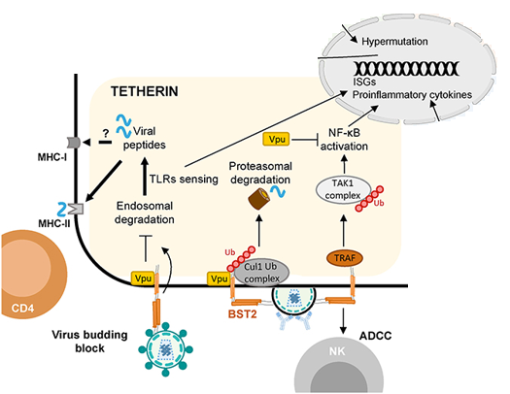
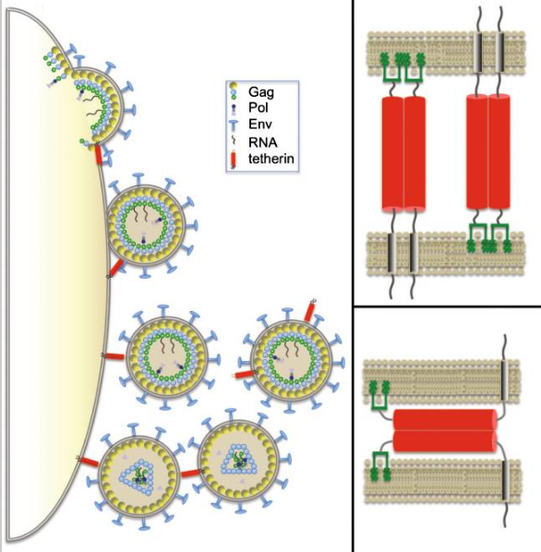
Bone Marrow Stromal Cell Antigen 2 (BST-2)/Tetherin
HIV-1 viral tethering
Tetherin mediated
immune responses
  Activate TLR
  MHC loading
  NF-κB activation -
  pro-inflammatory responses
  NK cell responses - ADCC
Kuhl et al. (2011). J Neuroimmune Pharmacol; 6(2):188-201
Colomer-Lluch et al. (2018). Front Immunol; 9:2876
Notes:
Bone Marrow Stromal Cell Antigen 2 commonly referred to as tetherin is an interferon-inducible, transmembrane protein with a unique “two-anchor” topology with a transmembrane domain (TMD) towards the N-terminus and a C-terminal glycophosphatidylinositol (GPI) anchor which allows it to tether enveloped virions to cell surface and eachother and prevent their release. The retained virions are then internalized and degraded via the endosomal/lysosomal pathway and the viral products activate TLRs and provide peptides for MHC loading. Furthermore, virion tethering activates NF-kappaBeta signalling cascade and induces the expression of pro-inflammatory genes. The restriction of virions on the cell surface expression enhances antibody opsonization of the cell and NK mediated killing of the cell by antibody-dependent cell-mediated cytotoxicity (ADCC). And so tetherin functions not only as a retriction factor but also a modulator of cellular mediated immunity against retroviruses.

Slide 6

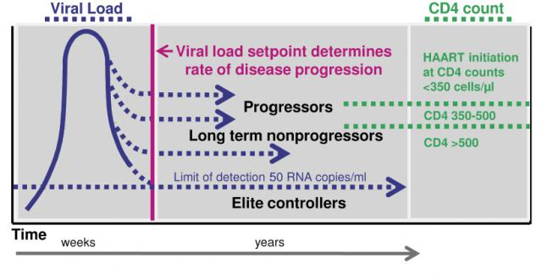
bst2 variants associated with HIV-1 disease
bst2 gene: 19p13.11
5’
3’
Black South African Population
rs3217318
(19bp INDEL)
rs12609479
(G/A)
rs10415893
(G/A)
rs113189798
(A/G)
bst-2 gene variant | HIV-1 disease outcome | Population | Reference
rs3217318 heterozygosity-Δ19/i19 rs10415893 heterozygosity-G/A | Faster disease progression Faster disease progression | Spanish injecting drug users | Laplana et al., 2013
rs12609479-A rs113189798-G | Decreased risk of HIV-1 acquisition Increased risk of HIV-1 acquisition | African & European Americans injecting drug users | Hancock et al., 2015
https://witsjusticeproject.files.wordpress.com/2013/04/sa-flag-on-hand_katrin-linke_fotolia.jpg
Durable Control of HIV-1 in absence of ART
Tiemessen. (2012). CME. 30(8):282-285
Notes:
As stated earlier, the role of bst2/tetherin genetic variants on HIV-1 disease susceptibility and progression is relatively understudied. The bst2 gene is located on chromosome 19 and in the schematic I have represented the four bst2 variants which have been previously reported to influence susceptibility to HIV-1 infection (Hancock paper) or disease progression as measured by CD4+T-cell decline and ART initiation (Laplana paper). It must be emphasized that all these studies were conducted using cohorts of injection drug users and although African Americans were included the Hancock study, most African-Americans have ancestry from several regions of western Africa. To our knowledge, no study has to investigated these HIV-1-associated bst2 variants in sub Saharan African populations, particularly the the black South African population, the population with the most severe burden. In Addition, the role of bst-2 gene variants in natural spontaneous control if HIV-1 viraemia, as seen in Elite controllers, has not been assessed.

Slide 7
Aims
Determine the frequency of FOUR bst-2 variants in
HIV-1 uninfected black South African population
Investigate whether these variants are associated with differential natural control of HIV-1 infection in the absence of
anti-retroviral therapy (ART)
Notes:
The aims of this study was to determine the frequency of these bst-2 variants in the HIV-1 uninfected black South African population (the background population) as well as to investigate whether these gene variants are associated with differential control of HIV-1 infection in the absence of anti-retroviral therapy (ART)

Slide 8
Study Cohort
Phenotypic Groups | CD4+ T-lymphocyte counts (cells/µl) | HIV-1 Viral Load (HIV-1 RNA copies/ml) | N
HIV-1 uninfected |  |  | 96
HIV-1 infected controllers |  |  | 71
Controller sub-groups:
Elite controllers (ECs) | >500 | <20 | 23
Viraemic controllers (VCs) | >500 | <2 000 | 37
High viral load long term non-progressors | >500 without decline for >7 yrs | >10 000 | 11
HIV-1 infected progressors | <300 requiring ARVs | >10 000 | 72
Notes:
Our study cohort included 96 HIV-1 uninfected black South Africans and 143 HIV-1 infected black South Africans that recruited from Soweto and Johannesburg, were categorized into two groups based on their inherent abilities to control HIV-1 infection in the absence of ARV therapy, namely: Controllers and progressors. The controller group, all with CD4 T cell count over 500 cells/ul, was comprised of 3 subgroups, the most important to mention being the elite controllers who are able to control HIV-1 viraemia to undetectable levels ( VL<20 RNA copies/ml)

Slide 9
Methods - Genotyping
INDEL: rs3217318 - Size discrimination gel electrophoresis
SNPs: rs12606479, rs10415893 and rs113189798 – Allele-specific real-time SYBRgreen PCR
bp
16
17
1
2
3
4
5
6
7
8
9
10
11
12
13
14
15
18
19
20
850 -
19bp insertion (mt)
400 -
- 361bp
- 342bp
19bp deletion (wt)
C Primer1
G
(wt)
ΔRn
ΔRn
ΔRn
G
G
A
A
T Primer2
A
(mt)
Cycle
Cycle
Cycle
G/G (wt)
G/A (het)
A/A (mt)
Notes:
The indel was genotyping was achieved by resolving PCR amplicons on super fine resolution gel. The deletion (the wild type allele) is depicted by arrow head, the insertion is depicted by arrow and heterozygotes have two bands.
Allele specific real-time PCR was used to detect single nucleotide polymorphisms. 2- primers were designed to per SNP, one complementary to the wt allele (Green) and one complementary to the mutant allele (purple). If the sample was homozygous widtype then primer 1 would amplify preferentially and appear at the lower Ct. If the sample is homozygous for the mutant allele, the primer 2 (purple) would bind preferentially and appear at a lower Ct. In heterozygous indviduals , both primers will bind and amplify equally well.

Slide 10
Results

Slide 11
Variant Representation in HIV-1 uninfected black South Africans
rs10415893
rs113189798
rs12609479
***p<0.001
Only genotype to differ significantly between
SA & Representative African Population
*p=0.047
61%
9%
2%
Reference Population data from 1000 Genomes project
Notes:
We compared our data to reference Caucasian and African data from the 1000 Genomes Project. Data was only available for the three SNPs, not the indel. genotype frequencies of the HIV-1 uninfected black South Africa population largely mirror those of the African reference population whilst being significantly higher than those frequencies detected in the reference Caucasian population. The only exception being homozygosity for the mutant allele at position 79 is significantly underrepresented in the South African population compared to reference African population. This minor allele was previously reported to decrease risk of HIV acquisition.

Slide 12
Representation of individual variants in HIV-1 infected subgroups
5’
3’
rs3217318
(19bp INDEL)
rs12609479
(G/A)
rs10415893
(G/A)
rs113189798
(A/G)
rs12609479
rs113189798
*p=0.03
p=0.07
47.2%
47.8%
21.7%
26.4%
Notes:
We next assessed whether representation of certain genotypes differed between our HIV-1 infected subgroups. Heterozygosity at 5’ SNP 79 was significantly underrepresented in Elite controllers compared to progressors whilst the opposite trend was observed for heterozygosity at the 3’ 98 SNP which showed a trend of enrichment in elite controllers.

Slide 13
Effect of individual variants on markers of disease progression
HIV-1 infected progressors
Notes:
We next considered whether each of the bst-2 variants in isolation notably influenced markers of disease progression. Only data for individuals with progressive disease are shown here. None of the variants when assessed individually influenced CD4+ T-cell count. However, heterozygosity for the promoter insertion was associated with significantly faster rates of CD4+T-cell decline. These findings are in accordance with those from a Spanish cohort of injecting drug users.

Slide 14
Effect of individual variants on markers of disease progression
HIV-1 infected progressors
Notes:
And homozygosity for the minor G allele at locus 98 was associated with significantly lower viral loads in individuals with advanced disease .

Slide 15
Combination of bst2 genotypes
5’
3’
rs32173
18
(19bp INDEL)
rs126094
79
(G/A)
rs104158
93
(G/A)
rs1131897
98
(A/G)
*p=0.03
p=0.07
Δ19Δ19 GG GG AA(wt)
Δ19Δ19 GA GG AA
Δ19i19 GG GA AG
-18
-79
-93
-98
-18
-79
-93
-98
-18
-79
-93
-98
Notes:
We next assessed the influence of genotype combinations on HIV-1 control. Visual inspection of the data revealed that heterozygosity at the 79 locus in a wildtype background was significantly underrepresented in ECs compared to progressors whilst the inverse, heterozygosity at all three loci and wildtype at position 79 was enriched in Elite controllers. And so we investigated the effect of genotype combinations on markers of disease progression.

Slide 16
Effect of combined variants on HIV-1 Control
HIV-1 infected progressors
Notes:
This genotype overrepresented in progressors is in pink and the genotype overrepresented in Elite controllers in very light green. Remarkably, the genotype combination that was enriched in Elite controllers was shown to be advantageous in individuals with advanced disease, as progressors carrying this genotype combination retained significantly higher CD4+ T-cell counts than those harbouring other combinations . Upon further stratification, it became apparent that the rs12609479 and rs11318798 (_GG_AG) diplotype was driving this protective effect.

Slide 17
Summary
Proposed Effect
of minor allele
19 insertion
Repress expression
A allele
Enhance expression
A allele
Repress expression
G allele
Modify Regulatory motif
5’
3’
rs3217318
(19bp INDEL)
rs12609479
(G/A)
rs10415893
(G/A)
rs113189798
(A/G)
G/A underrepresented in ECs
A/G enriched in ECs
Our Findings with natural HIV-1 Control
Δ19/i19 Faster CD4+T-cell decline in Progressors
G/G + A/G
higher CD4+T-cell count in Progressors
Notes:
In summary , we investigated four bst2 polymorphisms reported to influence HIV-1 disease progression in injecting drug users. The promoter indel and the minor A-allele at the 93 locus were reported to repress bst-2 expression. The rs12609479-A allele has been proposed to enhance transcription factor (c-Myb) binding in the bst-2 promoter and thereby augment bst-2 expression levels and the rs113189798-G allele. Bioinformatics analyses suggested that this bst-2 variant is located in a DNase hypersensitivity site (DHS) and may potentially modify three regulatory motifs thereby potentially altering bst-2 expression.
In our study, 79- A allele and heterozygosity at the 79 locus was underrepresented in Elite controllers whilst heterozygosity for the G-allele at locus 98 was enriched in Elite controllers. Heterozygosity for the promoter indel was associated with faster rates of CD4+T-cell decline, in line with the proposed functional consequence of this variant. And Finally carriage of the GG_AG_ genotype combination was shown to be associated with higher CD4 Tcell counts in progressors suggesting that the 79-A allele may be detrimental whilst the G-98 allele may confer an advantage with respect to HIV disease progression.

Slide 18
Limitations
Only investigated polymorphisms previously shown to be associated with HIV-1 disease in adults
Small sample size
Did not adjust for multiple comparisons
  Extreme Clinical Phenotypes
  Validation in larger cohort required
Notes:
There a number of limitations to our study, the first being that we only considered polymorphisms which has previously been reported to influence HIV-1 acquisition or disease progression in adult populations. There are other bst2 polymorphisms reported to influence mother-to-child transmission as well as affect the protein’s viral endocytosis and signal transduction capabilities that may warrant further investigation.
Non-synonymous mutations, resulting in alterations to the primary amino acid sequence, do not impair virion restriction by BST-2 as long as the general protein structure and conformation is retained. It has been reported that such polymorphisms may alter BST-2 functionality either through reducing rates of viral internalization (rs141648094, Y8H) or abrogating NF-ĸβ signaling (R19H).
Our sample sizes were also quite small and adjustments for multiple comparisons were not performed. Although the power of the study was increased by examining extreme phenotypes (such as Elite controllers and progressors) these findings will need to be validated in larger cohorts.
Due to the exploratory nature of this research, the aim of which was to identify genetic factors potentially associated with natural HIV-1 control, adjustments for multiple comparisons were not performed as these increase the risk of type II errors (failure to detect an effect that is indeed present).

Slide 19
Conclusion
Determined the frequency of FOUR bst-2 polymorphisms in the black South African population
  rs3217318, rs10415893 and rs113189798 had not yet been previously described
First to investigate these bst-2 variants (rs3217318, rs12609479, rs10415893 and rs113189798) in the context of differential spontaneous control of HIV-1 infection, particularly in black South Africans
  rs3217318-Δ19/i19 – associated with faster CD4+T-cell decline in progressors
  rs12609479 (G/G) and rs113189798 (A/G) combined genotype associated with higher CD4+T-cell counts in progressors
These data suggest possession of select combinations of bst-2 genotypes
may influence HIV-1 disease progression and spontaneous HIV-1 control
Notes:
The present study we determined the frequency of 4 bst2 variants previously associated with variability in HIV-1 disease, 3 of which were previously uncharacterized in the black South African population. This is also, to our knowledge, the first study describing these bst-2 variants (rs3217318, rs12609479, rs10415893 and rs113189798) in the context of differential spontaneous control of HIV-1 infection, particularly with respect to black South Africans. We further showed that heterozygosity for the promoter indel was associated with faster rates of CD4 decline in progressors whilst carriage of the 79GG and 98A/G combined genotype was associated with higher CD4 t-cell counts in these individuals.
further investigations into the mechanisms underlying the role of BST-2 in promoting spontaneous antiviral immunity to HIV pathogenesis are of utmost importance and may be invaluable in the design of novel therapies aimed at attaining a “functional cure” for HIV-1

Slide 20






Acknowledgements
Study Participants
Colleagues & Collaborators
CHIVSTI: Cell Biology
Caroline T. Tiemessen
Maria Paximadis
Ziyaad Waja
Neil Martinson
Osman Ebrahim
Richard E. Chaisson
Funding
Notes:
I would like to thank the study participants, my colleagues and collaborators and funders.

Slide 21

Conflict of Interest
None to declare
Ngiyabonga
Dankie
Thank You
https://www.istockphoto.com/za/vector/south-africa-icon-montage-gm165790129-20069398
Notes:
Thank you.

